Slide 1

Employee Travel Booking Application
By ASP.Net MVC Application using C#
Team - 2
Adikesava Thummala - 1035478
Sripriya Ragunath - 1035503
Sahana Navali - 1035495
Vijendra Tripathi - 1035471
Palepu Uhalatha - 1035585
Nithin Jagadeesh - 1035476

Slide 2
Problem Statement
Need to develop Employee Travel Booking System Using ASP.NET MVC, ASP.NET Web API & Entity Framework
Abstract
Employee Travel Booking Application allows Employees to place requests for booking business travel tickets.
In current corporate world, Employees are often required to travel to Domestic as well as international locations based on business requirements. This application “Employee Travel Booking Application” will help employees to raise or submit a ticket for travelling to the required location.
Employee Travel Booking System is an online system which will automate the process of raising or placing a travel requests. Employees will raise or place the travel request. Manager can approve, reject the request. Once manager approves the request travel agent will confirm the travel or can make the status as Bookings not available.

Slide 3
The system will have 4 users / actors: Employee, Manager, Travel Agent, and Admin
Role of Admin
Add Employee, Assign manager
Change Manager, Delete Employee.
Add/Edit Travel Agents
Role of Employee
Check current requests submitted and see the status
Raise new travel request
Cancel the request made
Role of Manager
Approve or Reject the travel request raised by Employee
Check the history of requests made by reporting employees.
Role of “Travel Agent”
Once Manager approves the travel request of employee, travel agent will change the status to
“Ticket Confirmed” or “No Availability” status.

Slide 4
Extra Features and Functionalities :
More Functionalities added for Admin
Employee Identity Proof Submission and can be Stored in DB
SMS Message sent By Travel Agent
Employee Can Download Travel Request with status as PDF format
Manager Can View His Employees
Reset Password option Enabled For Employees and Managers

Slide 5
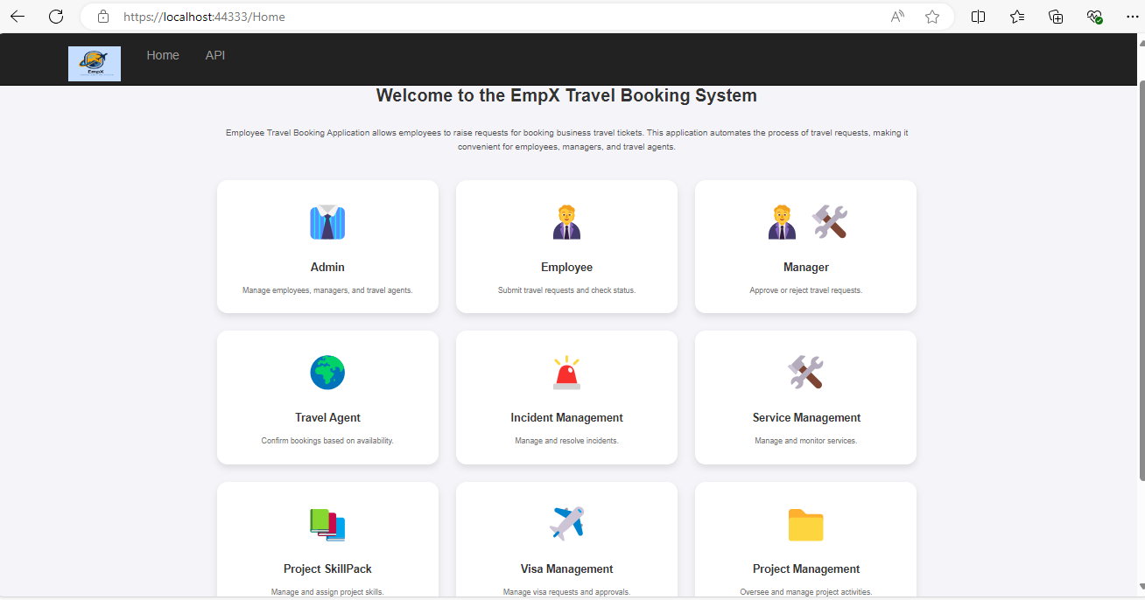
Home Dashboard Page

Slide 6
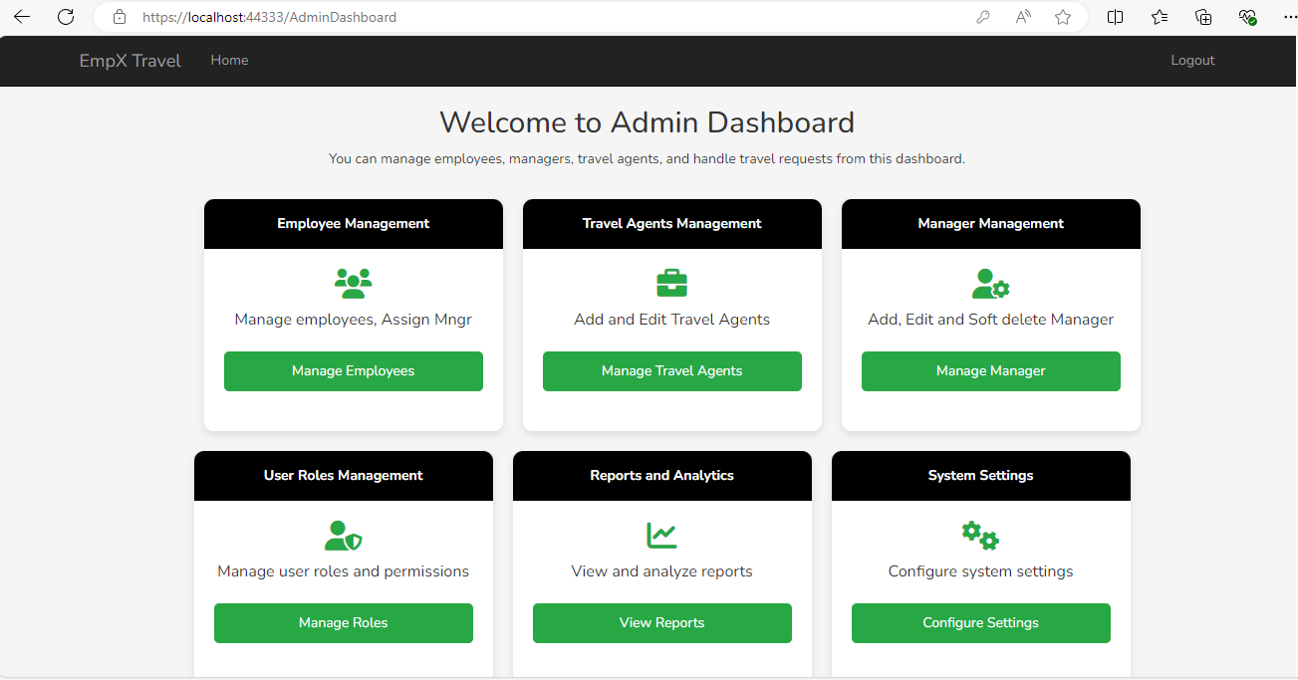
Admin Dashboard :

Slide 7
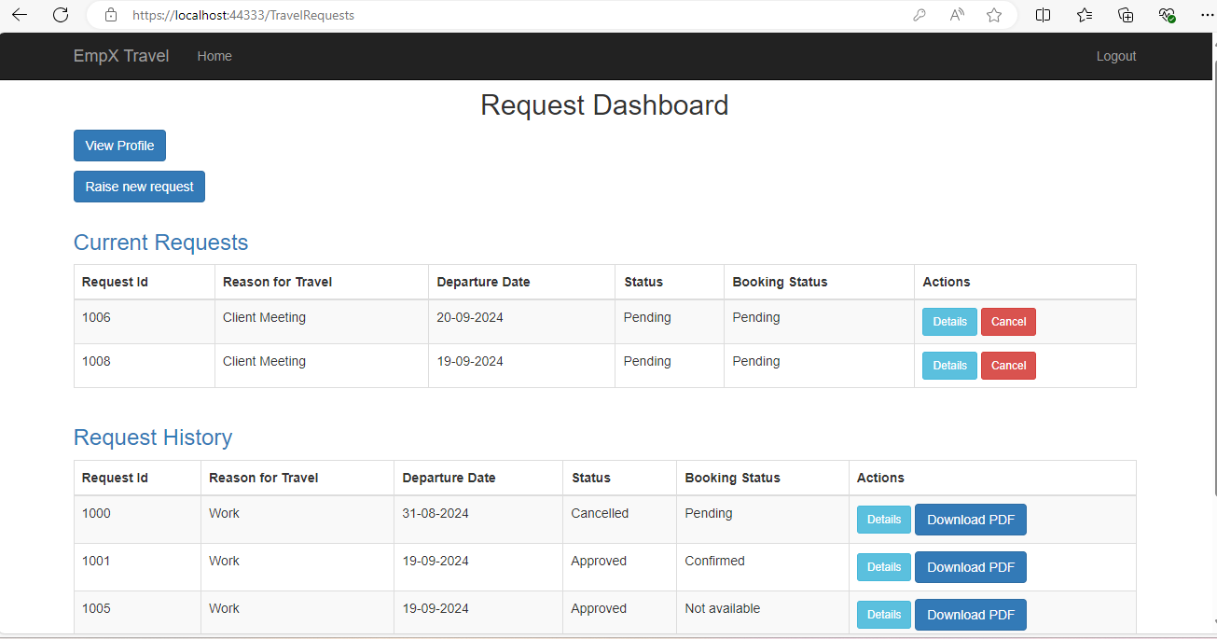
Employee Dashboard

Slide 8
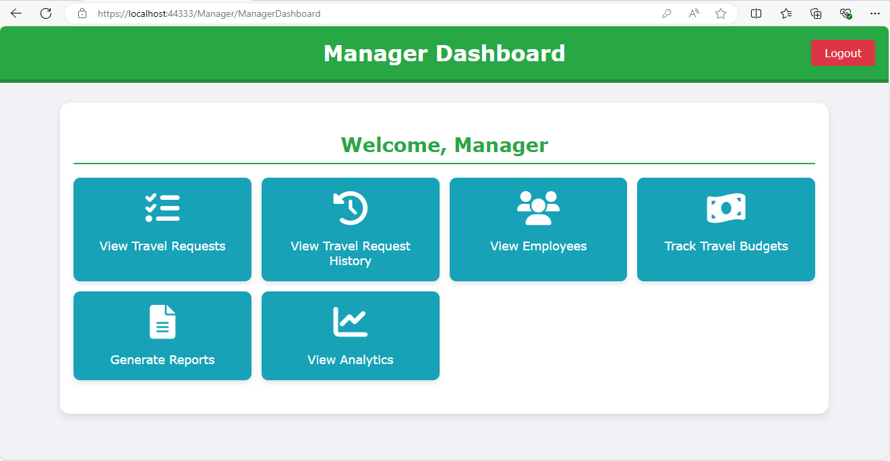
Manager Dashboard

Slide 9
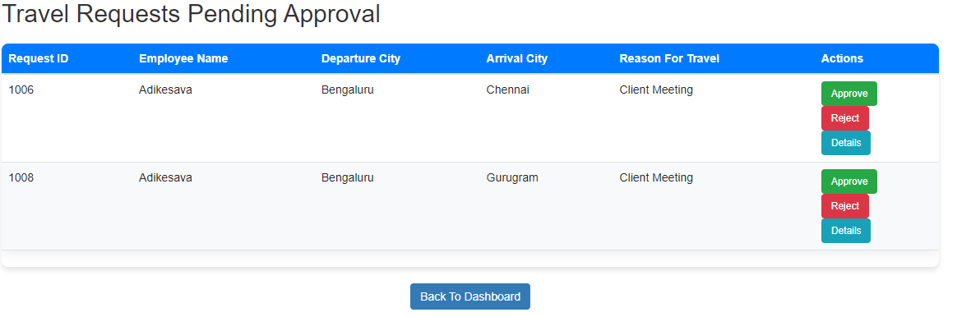
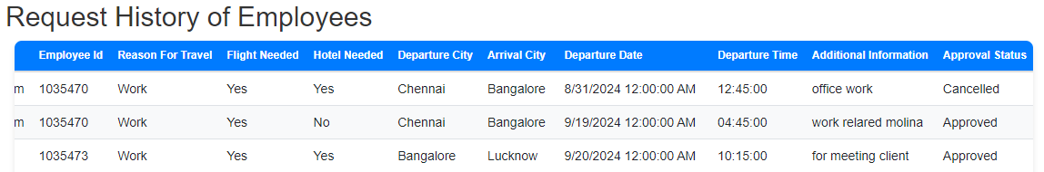
View Requests
View Requests History

Slide 10
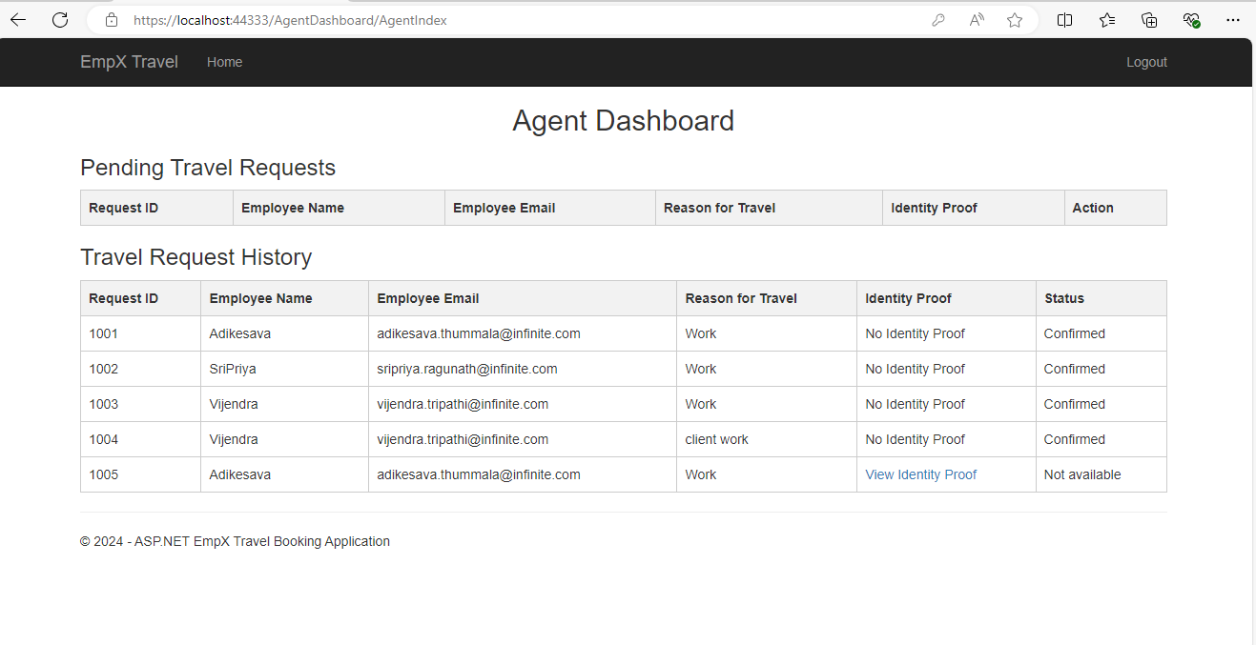
Travel Agent Dashboard

Slide 11
THANK YOU

